Slide 1
Piko Park Implementation
By Chandler Mason, Justin Morgan, Ritchie Williams, Jack Dingman, and Daniel Hoelzeman

Slide 2
Introduction
We’ve developed a cooperative 2-4 player platformer with both local and online support in which players work together to complete levels, pursue side objectives to earn individual medals, and ultimately compete for the highest medal count to determine the winner

Slide 3
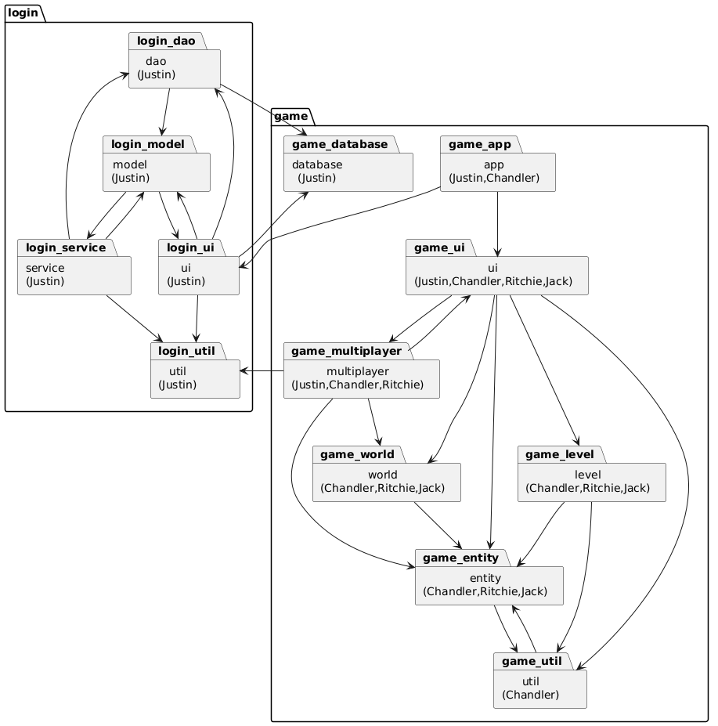
Package Diagram

Slide 4
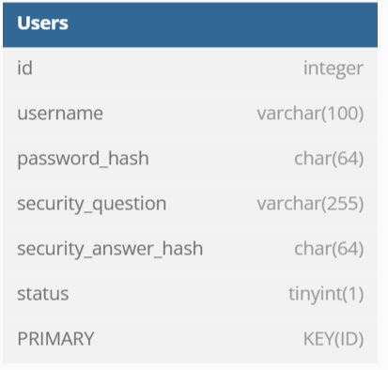
Database Design

Slide 5
Functional Requirements
“Players must navigate to the end of each stage utilizing cooperation.“
This functional requirement showcases the users ability to move, jump, push blocks, and utilize buttons to spawn platforms and respawn if they fall off the map

Slide 6

Use Case Description: Move
Move:
Related Use Case
Included by: Player
Actor: Player
Player pressed a movement key
System verifies the movement is valid
If valid, player character moves / jumps in the desired direction
Entry Condition:
Player is in an active game session
Exit Condition:
Players character moves accordingly

Slide 7

Use Case Description: Push
Push
Actor: Player
Player makes contact with an inanimate object, not a player
System will move the object with the player, until the player changes direction
Entry Condition:
Movement towards an object that is movable
Exit Condition:
Directional Change to move away from an object

Slide 8

Use Case Description: ButtonSwitchTiming
ButtonSwitchTiming
Actor: Player
One or more players stand on a button
System activates a mechanism
If the player steps off the button, the mechanism inactivates
Players must time their actions correctly to progress
Entry Condition:
At minimum one player or object must stand on a button
Exit Condition:
The player or object moves off of the button
Maybe Add video here

Slide 9
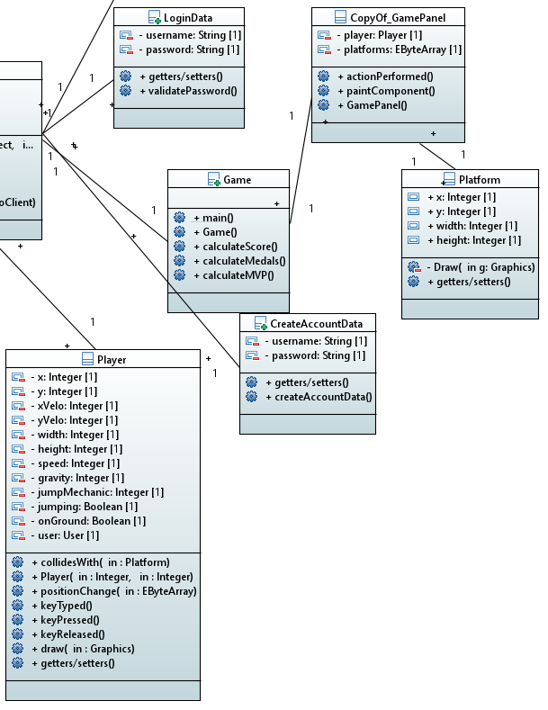
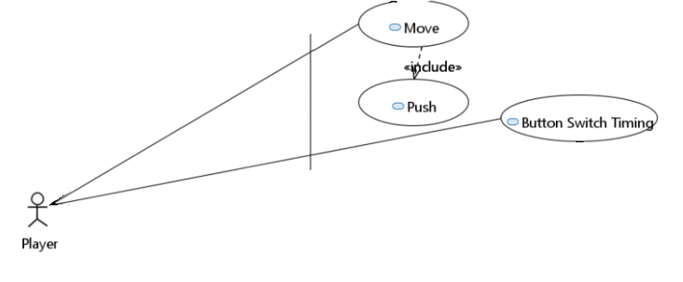
Initial Class and Use Case Diagrams

Slide 10
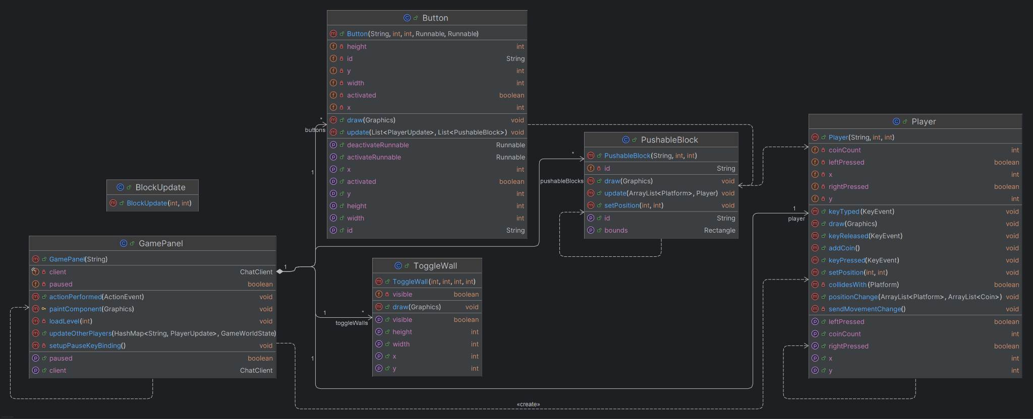
Final Class Diagram

